Slide 1


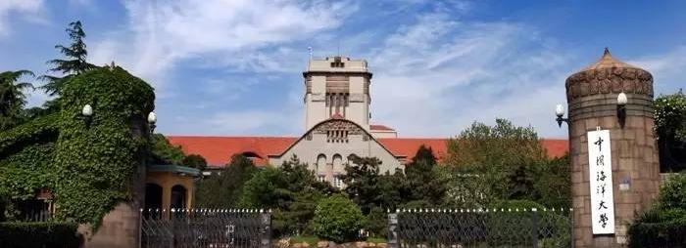




SFWICT 2017
Sino-French workshop on information and communication technology
Qingdao, China | June ${6−8}^{th}$, 2017
CALL FOR PAPERS
Introduction
Important Dates
The 7th Sino-French Workshop on information and communication technology (SFWICT2017) will be held at ‘Ocean University of China’ on June 6^th, 2017. This workshop, specially oriented on research collaborations, aims at bringing together international researchers to discuss on the latest scientific and theoretical advances on information, communication, electronic and electrical systems in order to raise new ideas in the framework of the common Sino-French Research Center established since November 2010. The program will include keynote speakers, senior and junior presentations, and a general opening ceremony. In order to encourage fruitful discussions and future collaboration plans, part of the program will be largely dedicated to interactive sessions. The topics include information, communication, electronic and electrical technology. We hope you can contribute to this conference by submitting a paper (5 pages) in English reflecting your current research in any of the following main topic areas (not limited) :
Submission Deadline
April 15th, 2017
Author Notification
April 30th, 2017
Invitation Letter
May 15th, 2017
Data Intelligence and Communication
— Data Intelligence in Computer Vision, Pattern Recognition and Machine Learning
— Computer Graph, Knowledge Management, Data Mining
— Multimedia Applications, Image and Video Processing, Discrete Geometry
— Affective Computing, Multimedia Quality Assessment and QoE
— Cloud Applications, Databases, Information Systems and Security, Multimedia Communication, Social
Networks, Network Design, Analysis and Management
— Human-Computer Interaction and Immersive Technologies (3D, HDR, UHD, Haptics. . . )
— Oceanographic data processing
— Network
Smart Signal Processing and Wireless Communications
— Smart Signal Processing for Communications and Radar
— MIMO and Multi-Antenna Communications
— Cooperative Communications
— Wireless Sensor Network Systems
— Cognitive Radio
— Green Communications and Energy Efficiency in Communication
— Control Theory
— Electrical Systems
— RF System Design
— Smart Energy
Conference
June 6-8th, 2017
Technical program committee
Mourad Ait Ahmed
Guillaume Andrieux
Marcus Barkowsky
Jean-Yves Baudais
Salah BOURENNANE
Patrick Le Callet
Pascal Chargé
Anne Chousseaud
Matthieu Crussière
Jean François Diouris
Xinghui Dong
Xinbo Gao
Christian Viard Gaudin
Marc Gelgon
Maoguo Gong
Jean Pierre Guedon
Hansheng Lei
Mohamed Machmoum
Yann Mahe
Qiguang Miao
Harold Mouchère
Nicolas Normand
Jean Christophe Olivier
Sebastien Pillement
Guillaume Raschia
Tchanguiz RAZBAN
Vincent Ricordel
Matthieu Perreira Da Silva
Didier Trichet
Yide WANG
Gang Wei
Xiangmin Xu
Yong Xu
Hui Yu
Yong Xu
Conference Organization
Steering Committee
Jean François Diouris | Nicolas Normand | Yide WANG
Ge Chen | Xinbo Gao | Gang Wei
General Chairs
Zhongwen Guo | Patrick Le Callet
Technical Program Chairs
Junyu Dong
Publicity Chairs
Guoqiang Zhong
Organizing Chairs
Bo Yu | Shanghai Qin | Junyu Dong | Bing Zheng

